Slide 1
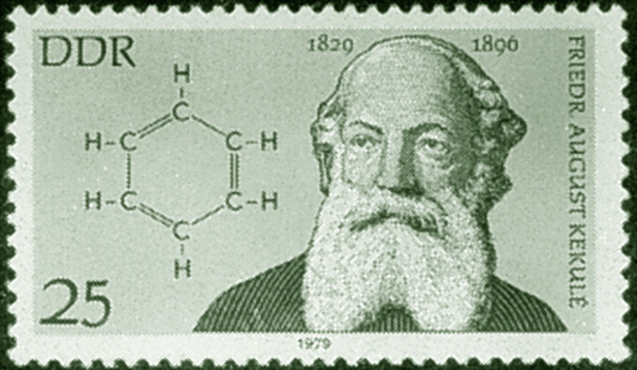
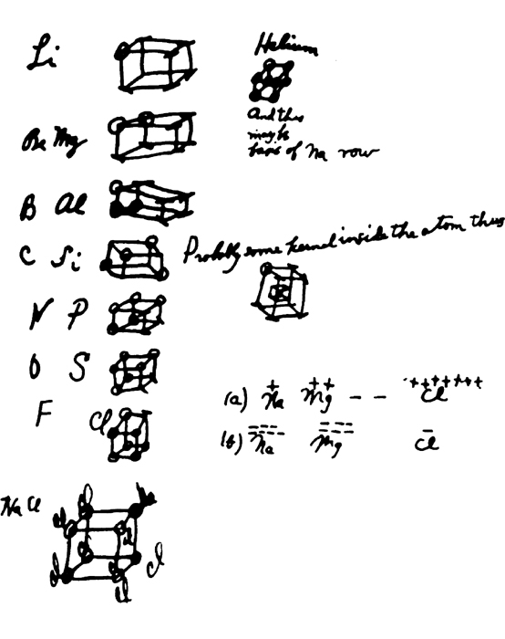
Chemical Bonding I:
Covalent Bonding
Chapter 9
Copyright © The McGraw-Hill Companies, Inc. Permission required for reproduction or display.

Slide 2
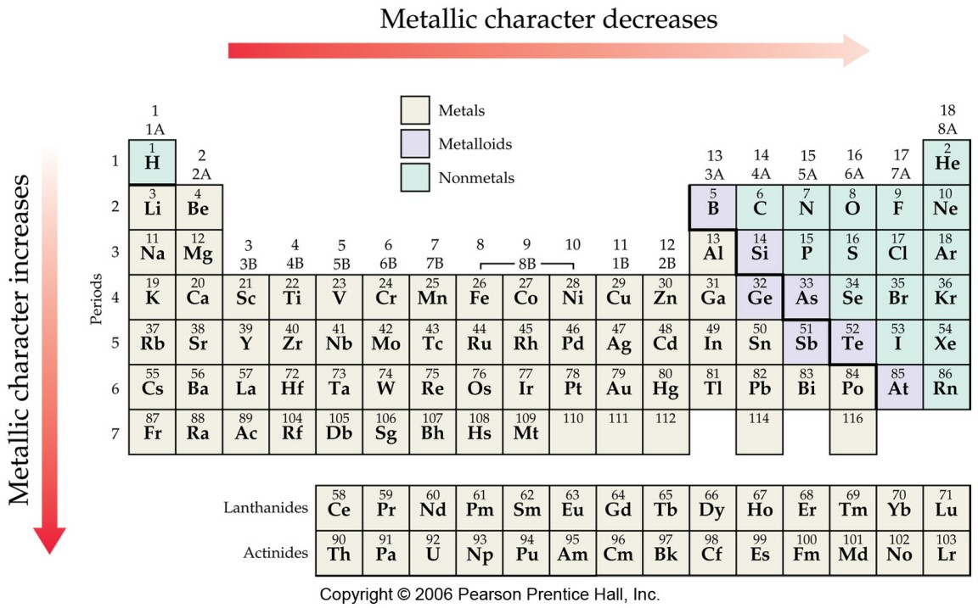
Trends in Metallic Character

Slide 3
Effective Nuclear Charge (Z_{eff})

Slide 4
Effective Nuclear Charge (Z_{eff})
Effective nuclear charge (Z_{eff}) is the “positive charge” felt by an electron.
Z_{eff} = Z - σ
0 < σ < Z (σ = shielding constant)
Z_{eff} ≈ Z – number of inner or core electrons
Z
Core
Z_{eff}
Radius (pm)
Na
11
10
1
186
Mg
12
10
2
160
Al
13
10
3
143
Si
14
10
4
132

Slide 5
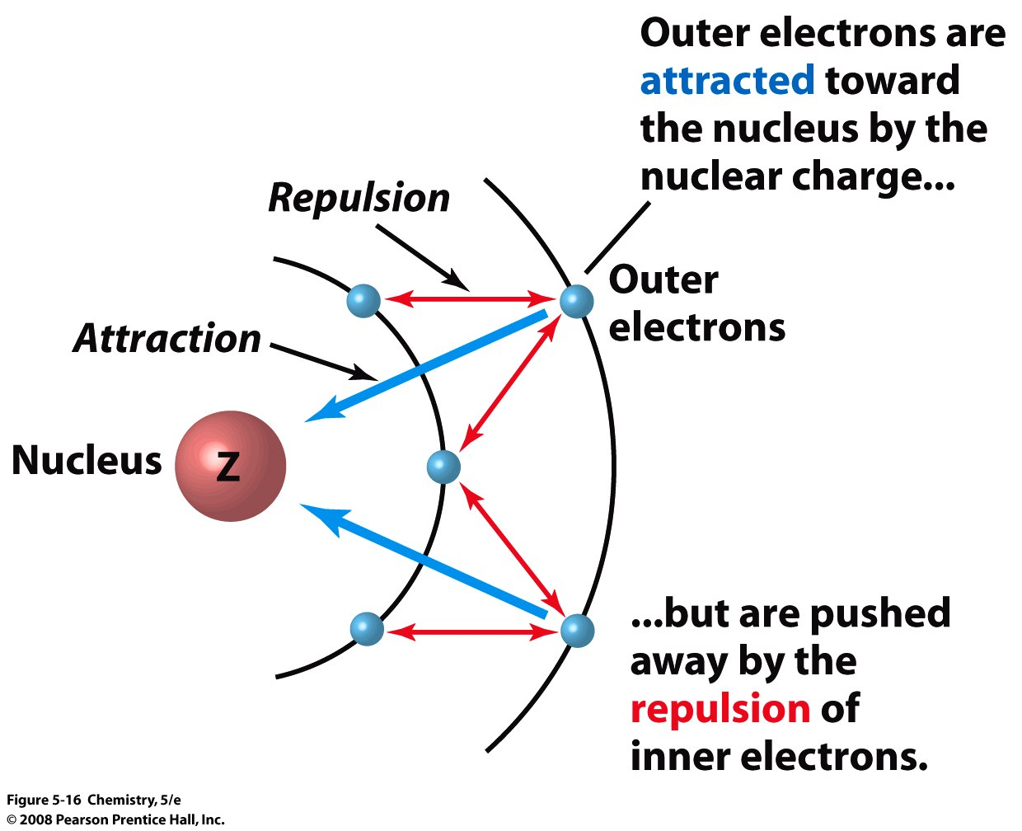
Effective Nuclear Charge (Z_{eff})
Z_{eff} = Z_{actual} – No. of Core Electrons or Electron shielding
Notes:
Chapter 5: Periodicity and Atomic Structure
Copyright © 2008 Pearson Prentice Hall, Inc.

Slide 6
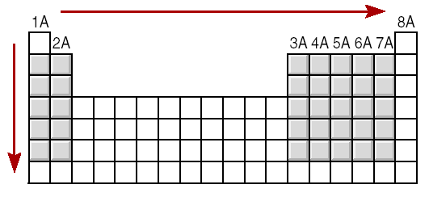
Effective Nuclear Charge (Z_{eff})
increasing Z_{eff}
decreasing Z_{eff}

Slide 7
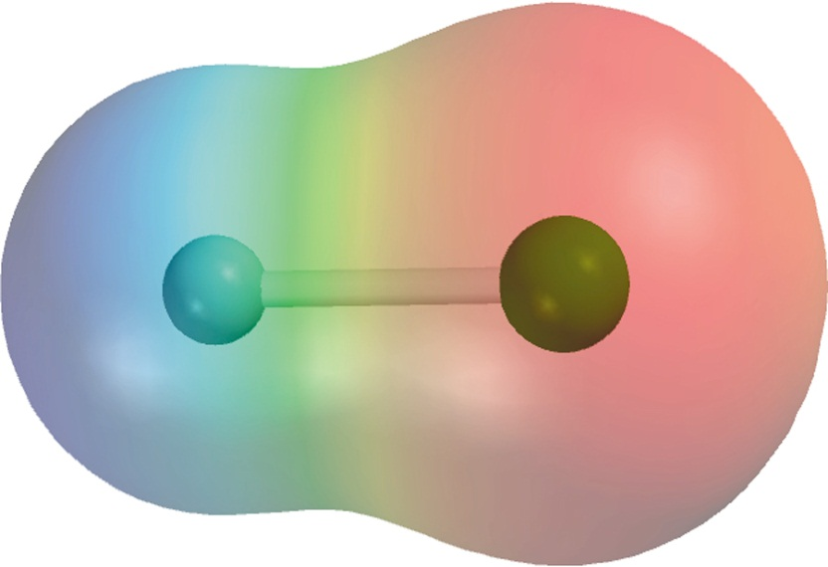
Electronegativity is the ability of an atom to attract toward itself the electrons in a chemical bond.
Electron Affinity - measurable, Cl is highest
X _{(g)} + e⁻ X⁻_{(g)}
Electronegativity - relative, F is highest
9.5

Slide 8
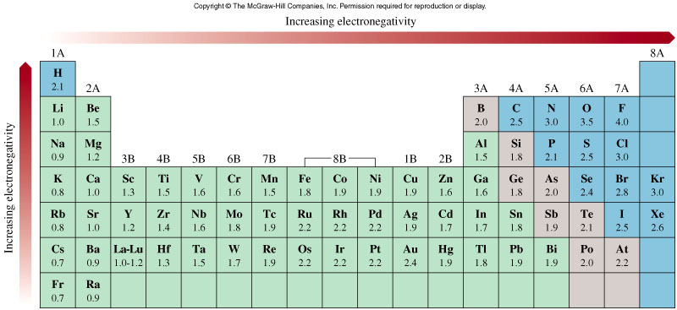
The Electronegativities of Common Elements
9.5

Slide 9
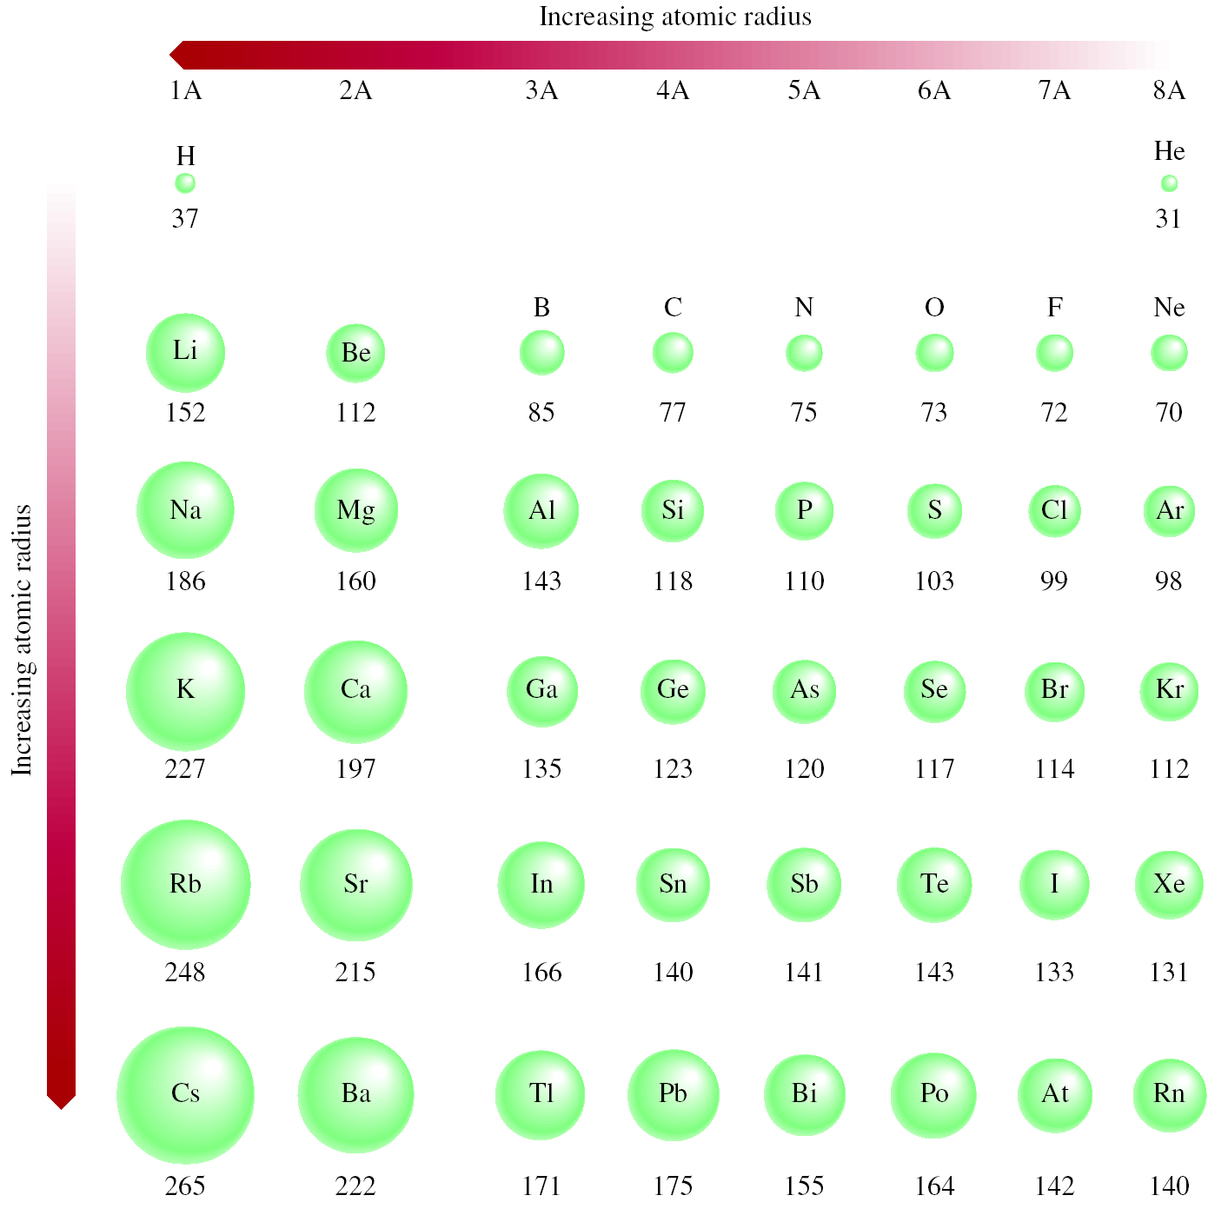

Slide 10
Ionization Energy
Ionization energy is the minimum energy (kJ/mol) required to remove an electron from a gaseous atom in its ground state.
I₁ + X _{(g)} X⁺_{(g)} + e⁻
I₁ first ionization energy
I₂ + X⁺_{(g)} X²⁺_{(g)} + e⁻
I₂ second ionization energy
I₃ + X²⁺_{(g)} X³⁺_{(g)} + e⁻
I₃ third ionization energy
I₁ < I₂ < I₃

Slide 11
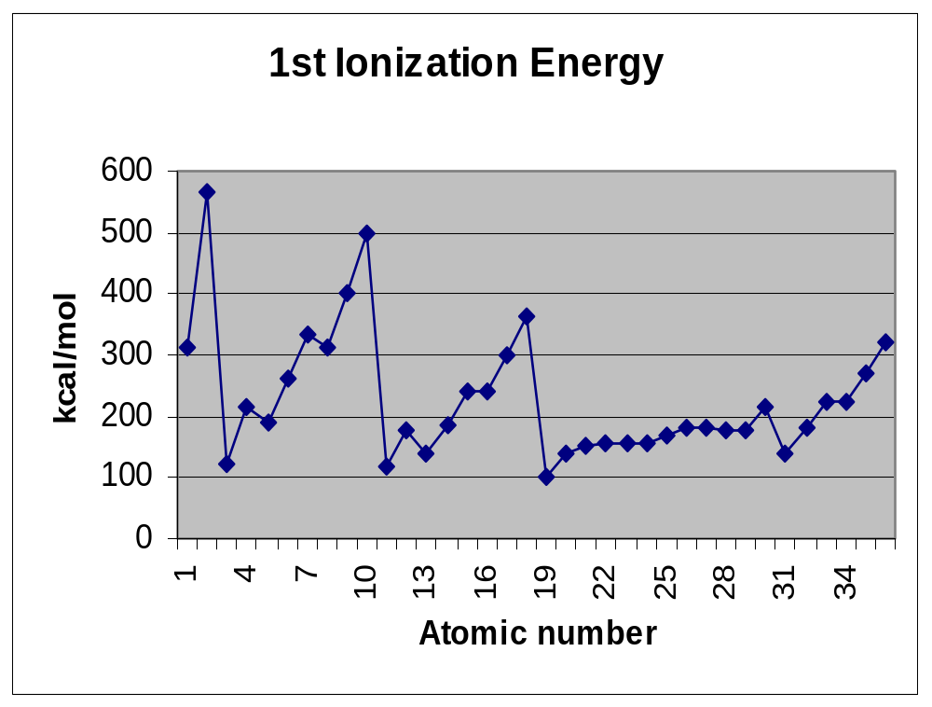
You can see each subshell and spin direction if you look closely
1s
2p
3p
4p
2p
3d
2s
3p
4p
3s
4s
3d

Slide 12
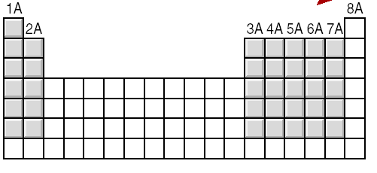
General Trends in First Ionization Energies
Increasing First Ionization Energy
Increasing First Ionization Energy

Slide 13
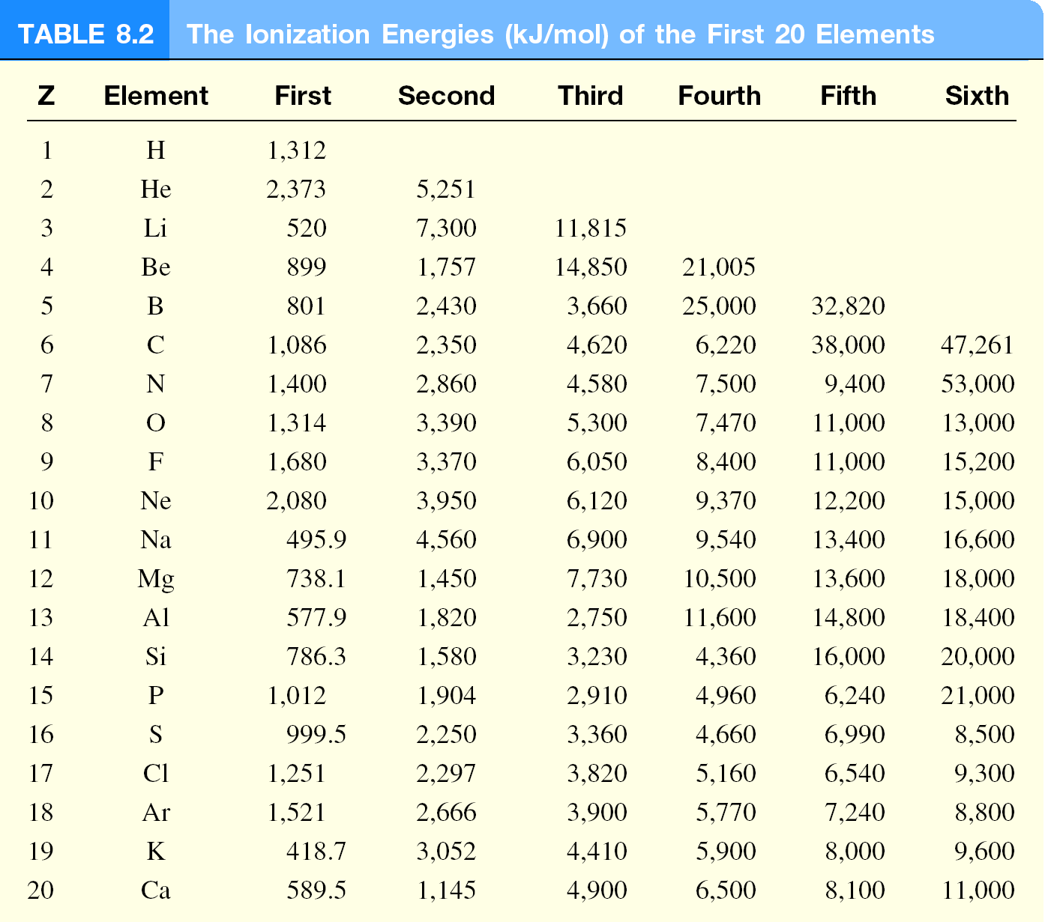

Slide 14
Electron Affinity
Electron affinity is the negative of the energy change that occurs when an electron is accepted by an atom in the gaseous state to form an anion.
X _{(g)} + e⁻ X⁻_{(g)}
F _{(g)} + e⁻ F⁻_{(g)}
ΔH = −328 kJ/mol
EA = +328 kJ/mol
O _{(g)} + e⁻ O⁻_{(g)}
ΔH = −141 kJ/mol
EA = +141 kJ/mol
O⁻ _{(g)} + e⁻ O²⁻_{(g)}
ΔH = +780 kJ/mol
EA = −780 kJ/mol
?
EA of O⁻ is highly –ve; i.e. O²⁻ formation is unfavorable,
electron-electron repulsion (g) > stability from noble gas configuration;
O²⁻ ion stabilized by neighboring cation, e.g. Li₂O, Mg₂O

Slide 15
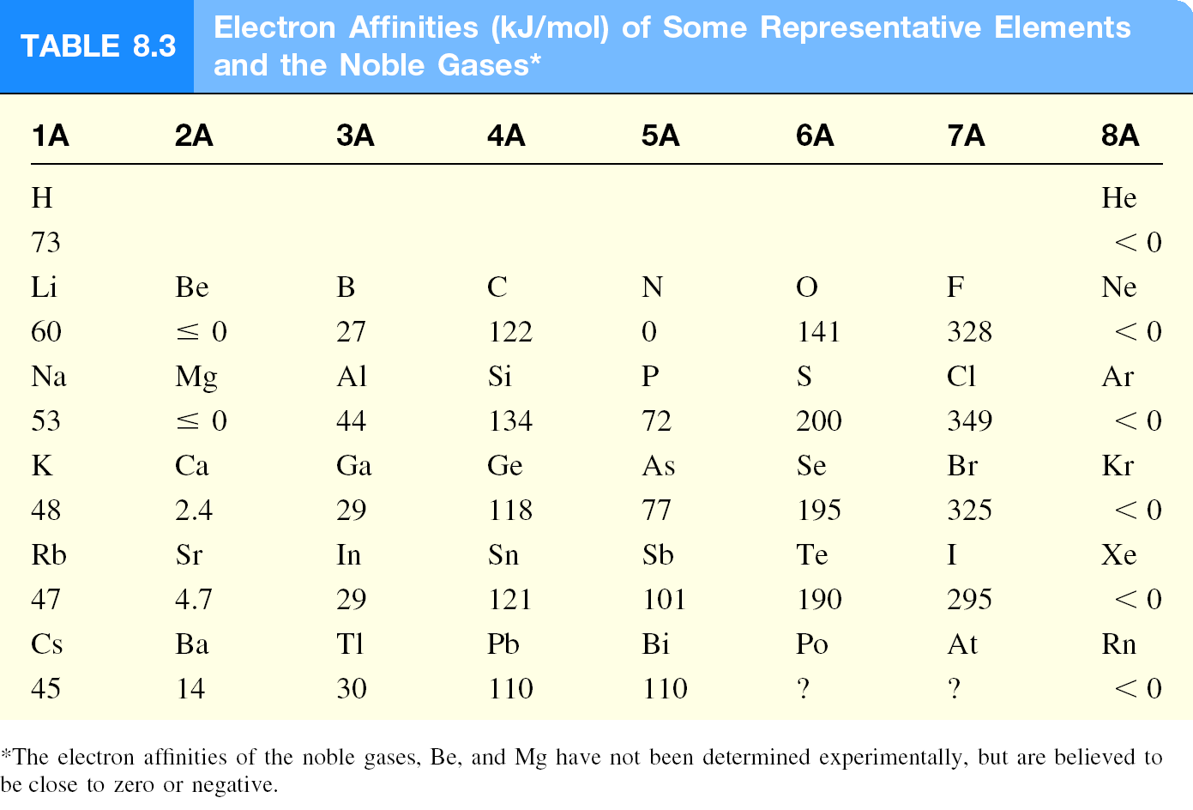

Slide 16
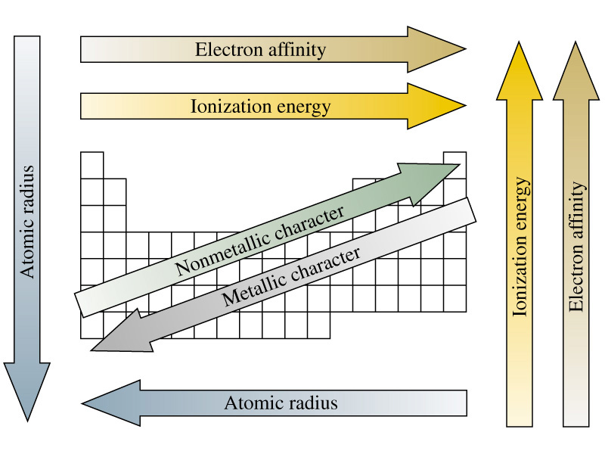
Periodic Properties of the Elements
Notes:
Chemistry 140 Fall 2002
Metallic character corresponds to conductance of heat and electricity.

Slide 17
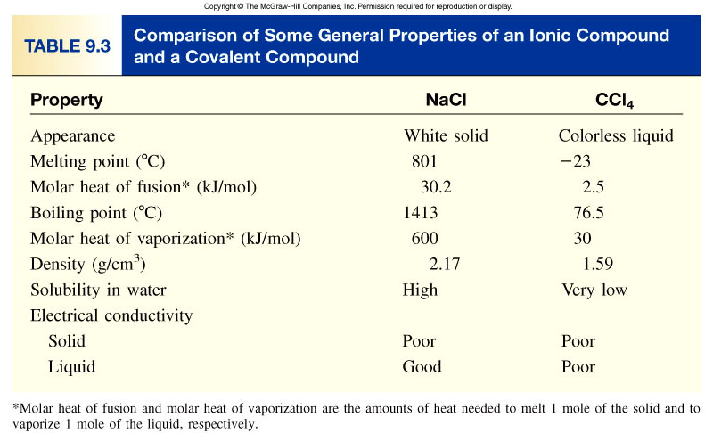
9.4

Slide 18
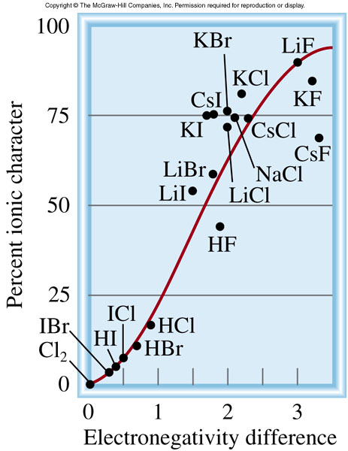
Classification of bonds by difference in electronegativity
Approximate Difference
Bond Type
0 to 0.4
Nonpolar Covalent
2 or greater
Ionic
0.5 to 1.9
Polar Covalent
Increasing difference in electronegativity
Nonpolar Covalent
Polar Covalent
Ionic
share e⁻ equally
partial transfer of e⁻
transfer e⁻
9.5

Slide 19
Three Major Types of Bonding
Ionic Bonding
  forms ionic compounds
  transfer of valence e⁻
Metallic Bonding
Covalent Bonding
  forms molecules
  sharing of valence e⁻
  This is our focus this chapter

Slide 20
Ionic Bonding
Always formed between metal cations and non-metals anions
The oppositely charged ions stick like magnets
[METALS ]⁺ [NON-METALS ]⁻
Lost e⁻
Gained e⁻

Slide 21
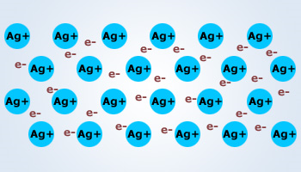
Metallic Bonding
Always formed between 2 metals (pure metals)
  Solid gold, silver, lead, etc…

Slide 22
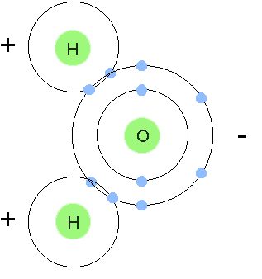
Covalent Bonding
molecules
Pairs of e- are shared between 2 non-metal atoms to acquire the electron configuration of a noble gas.

Slide 23
Valence electrons are the outer shell electrons of an
atom. The valence electrons are the electrons that
particpate in chemical bonding.
Group
e⁻ configuration
# of valence e⁻
1A
ns¹
1
2A
ns²
2
3A
ns²np¹
3
4A
ns²np²
4
5A
ns²np³
5
6A
ns²np⁴
6
7A
ns²np⁵
7
9.1

Slide 24
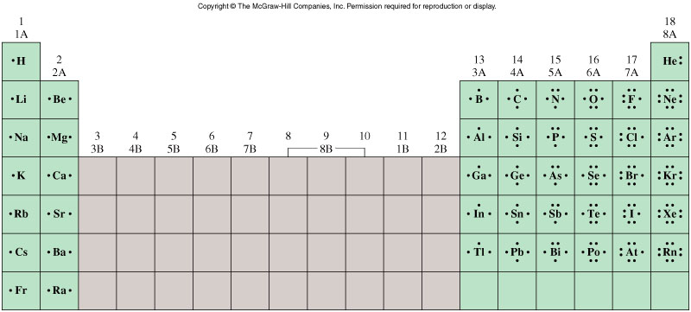
Lewis Dot Symbols for the Representative Elements &
Noble Gases
9.1

Slide 25
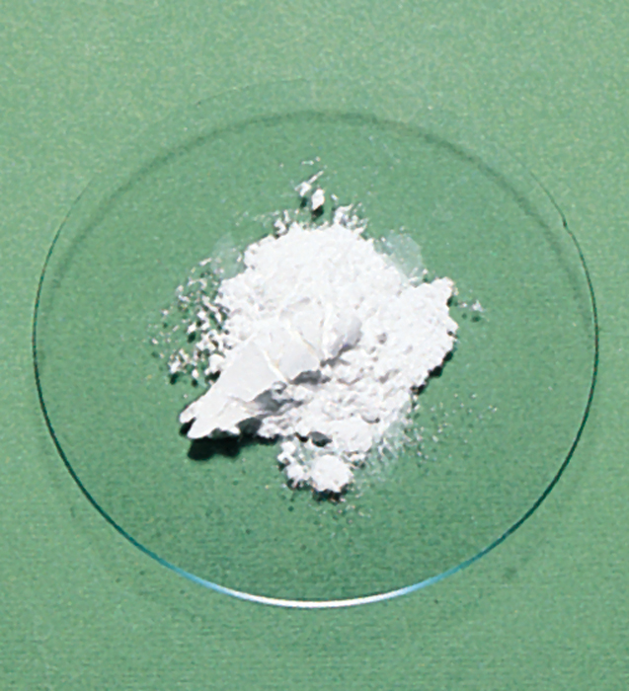
The Ionic Bond
Li
+
Li⁺
-
F
F
1s²2s¹
1s²2s²2p⁵
[He]
[Ne]
1s²
1s²2s²2p⁶
Li
Li⁺ + e⁻
e⁻ +
-
F
F
-
-
Li⁺ +
F
Li⁺
F
9.2

Slide 26
Electrostatic (Lattice) Energy
Lattice energy (E) is the energy required to completely separate one mole of a solid ionic compound into gaseous ions.
Q₊ is the charge on the cation
Q₊Q₋
E = k
Q₋ is the charge on the anion
r
r is the distance between the ion
centers
cmpd
lattice energy
MgF₂
2957
Q= +2,-1
Lattice energy (E) increases as Q increases and/or
as r decreases.
MgO
3938
Q= +2,-2
LiF
1036
r F⁻ < r Cl⁻
LiCl
853
9.3

Slide 27
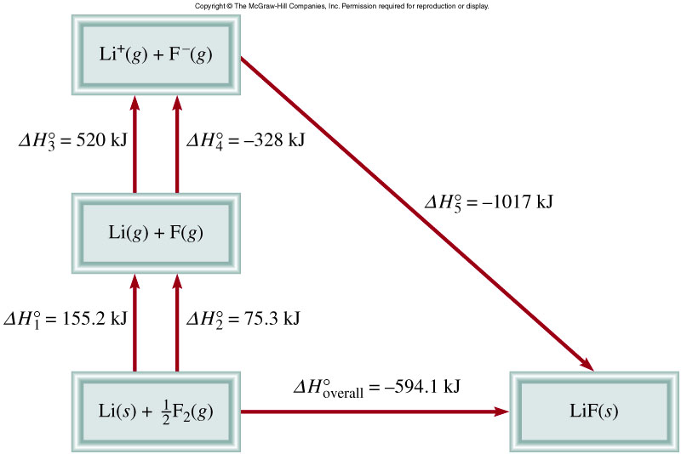
Born-Haber Cycle for Determining Lattice Energy
o
o
o
o
o
o
ΔH_{overall} = ΔH₁ + ΔH₂ + ΔH₃ + ΔH₄ + ΔH₅
9.3

Slide 28
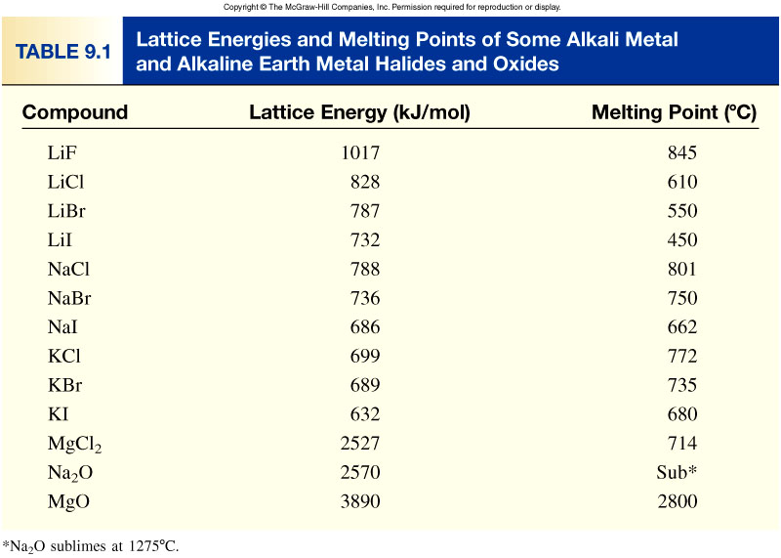
9.3

Slide 29

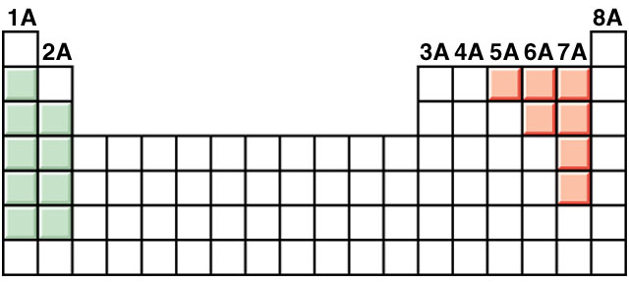
Classify the following bonds as ionic, polar covalent,
or covalent: The bond in CsCl; the bond in H₂O; and
the NN bond in H₂NNH₂.
Cs – 0.7
Cl – 3.0
3.0 – 0.7 = 2.3
Ionic
H – 2.1
O – 3.5
3.5 – 2.1 = 1.4
Polar Covalent
N – 3.0
N – 3.0
3.0 – 3.0 = 0
Nonpolar
Covalent
9.5

Slide 30
H₂, the Hydrogen Molecule
MasterCard
Sigma National Bank

Slide 31
H₂, the Hydrogen Molecule
Each hydrogen has a noble gas configuration through sharing
Each hydrogen has a noble gas configuration through sharing
e⁻
P⁺
P⁺
e⁻

Slide 32
Diatomic Halogen Molecules
The halogens all form diatomic molecules containing a sigma bond
F₂ Cl₂ Br₂ I₂
By sharing one e⁻ apiece they each achieve a noble gas configuration
F - F

Slide 33
Diatomic Halogen Molecules
The halogens all form diatomic molecules containing a sigma bond
F₂ Cl₂ Br₂ I₂
By sharing one e⁻ apiece they each achieve a noble gas configuration
F - F
σ

Slide 34
Lewis Structures

Slide 35
Lewis Structures
Sharing of electron pairs can be diagrammed in detail with Lewis Electron Dot Structures
Each atom begins with its valence electrons
A dash represents two shared electrons in a bond
Unbonded electrons are kept in lone pairs

Slide 36
Three types of covalent bonds
A Single Bond – only a pair of electrons are shared between two atoms
A Double Bond – two pairs of electrons are shared between two atoms
A Triple Bond – three pairs of electrons are shared between two atoms
Again un-bonded electrons are kept in lone pairs

Slide 37
A covalent bond is a chemical bond in which two or more electrons are shared by two atoms.
Why should two atoms share electrons?
F
+
F
F
F
7e⁻
7e⁻
8e⁻
8e⁻
Lewis structure of F₂
single covalent bond
lone pairs
F
F
lone pairs
single covalent bond
lone pairs
F
F
lone pairs
9.4

Slide 38
Lewis structure of water
single covalent bonds
H
+
O
+
H
H
O
H
or
H
O
H
2e⁻
8e⁻
2e⁻
Double bond – two atoms share two pairs of electrons
O
C
O
or
O
C
O
8e⁻
8e⁻
8e⁻
double bonds
double bonds
Triple bond – two atoms share three pairs of electrons
N
N
or
N
N
8e⁻
8e⁻
triple bond
triple bond
9.4

Slide 39
The Double Bond

Slide 40
The O₂ Molecule
O O
An octet for the left oxygen
An octet for the right oxygen

Slide 41
The O₂ Molecule
O O
The traditional Lewis structure for O₂

Slide 42
The Double Bond
There are 2 pairs of electrons shared
The first pair is in a σ-bond
Second pair is a new type of covalent bond -
a pi bond (π-bond)

Slide 43
The Double Bond
π⁺-orbital
O
σ-orbital
O
π⁻-orbital

Slide 44
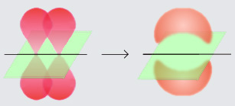
Better depictions of a double bond
Forming the two lobes of a π-orbital
http://en.wikipedia.org/wiki/Image:Pi-bond.jpg

Slide 45
The Double Bond
If I slice the double bond in half...
π⁺-orbital
O
σ-orbital
O
π⁻-orbital

Slide 46
The Double Bond
…it looks like this
π⁺-orbital
σ-orbital
π⁻-orbital

Slide 47
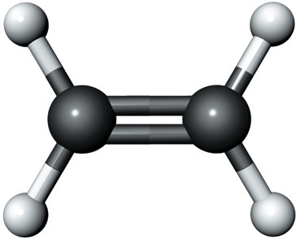
Your text’s (poor) depiction of a double bond

Slide 48
The O₂ Molecule
O O
σ
π
An official Lewis structure
one σ-bond
one π-bond
Four lone pairs

Slide 49
Double Bonding Elements
Only five elements participate in double bonds
⁶ C
⁷ N
⁸ O
¹⁵P
¹⁶S

Slide 50
The N₂ Molecule
N N
The left nitrogen has achieved an octet
The right nitrogen has achieved an octet

Slide 51
The N₂ Molecule
N N
The traditional Lewis structure for N₂

Slide 52
The Triple Bond
There are 3 pairs of electrons shared
The first pair is in a σ-bond
The second pair is in a pi-bond (π-bond)
The third pair is in a second pi-bond (π-bond)

Slide 53
The Triple Bond
If I slice the triple bond like this...
π₁⁺-orbital
N
σ-orbital
π₂⁻-orbital
N
π₁⁻-orbital

Slide 54
The Triple Bond
…it looks like this
π₁⁺-orbital
π₂⁺-orbital
σ-orbital
π₂⁻-orbital
π₁⁻-orbital

Slide 55
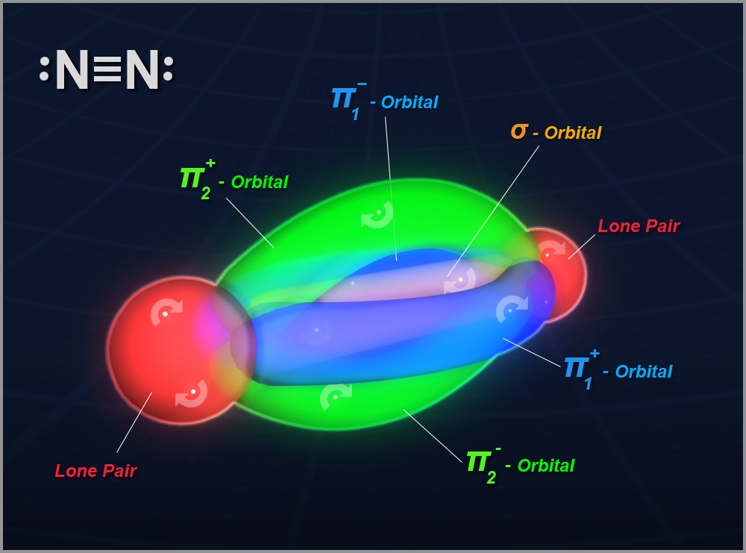

Slide 56
The N₂ Molecule
π₁
N N
σ
π₂
So a triple bond is
a σ-bond
and 2 π-bonds
In N₂ there are two lone pairs, too

Slide 57
Triple Bonding Elements
Only three elements participate in triple bonds
⁶ C
⁷ N
⁸ O

Slide 58
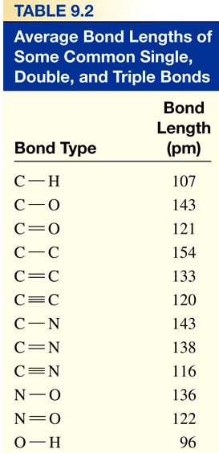
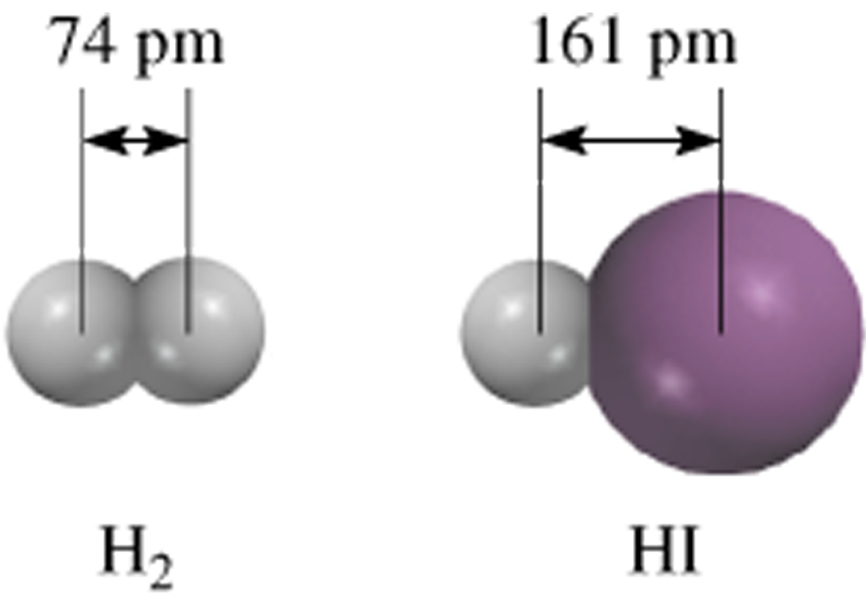
Lengths of Covalent Bonds
Bond Lengths
Triple bond < Double Bond < Single Bond
9.4

Slide 59
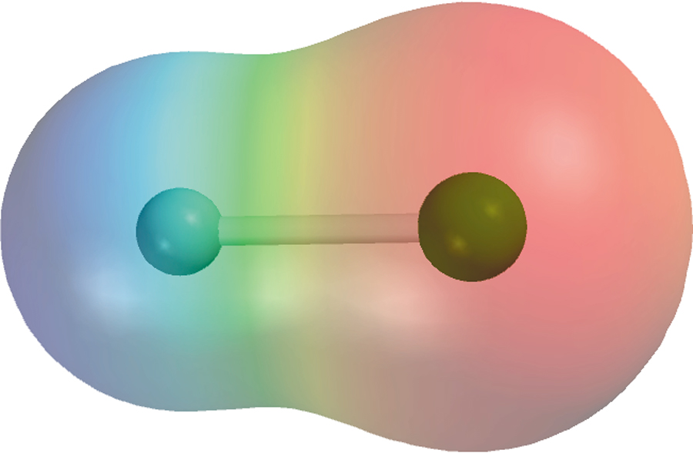
Polar covalent bond or polar bond is a covalent bond with greater electron density around one of the two atoms
electron rich
region
electron poor
region
e⁻ poor
e⁻ rich
H
F
H
F
δ⁺
δ⁻
9.5

Slide 60
General Rules for Lewis Structures
1. Find total # of valence e-’s in molecule or ion
2. Connect the skeleton with single bonds
3. Place lone pairs to give non-H terminal atoms an octet
Check to see how many e⁻’s are left and if all octets
(duets) are satisfied
If e⁻’s still left, go to 4
If e⁻’s are short, go to 5
If e⁻’s just right, you’re done
4. Place remaining e⁻’s on central atom (but check)
5. If short e-’s, look for multiple bonders or e⁻ deficients

Slide 61
Simple Lewis Structures
Element Bonds Lone pairs
H 1
C 4
N 3-4 1- 0
P 3-4 1- 0
O 2 2
S 2 2
Halogens 1 3

Slide 62
Example 1: Water
First, you need the molecule’s skeletal structure
I’ll provide this or give you enough information to deduce it
For example, in water, oxygen is the central atom

Slide 63
Example 1: Water
H
O
H

Slide 64
Example 1: Water
H
O
H
Central atom

Slide 65
Example 1: Water
H
O
H
Terminal atoms

Slide 66
Example 1: Water
H
O
H
Now start checking each atom for its typical bonding pattern

Slide 67
Example 1: Water
H
O
H
Each hydrogen forms one covalent bond

Slide 68
Example 1: Water
H
O
H
Each hydrogen forms one covalent bond

Slide 69
Example 1: Water
H
O
H
Each hydrogen forms one covalent bond

Slide 70
Example 1: Water
H
O
H
Oxygen forms two covalent bonds and has 2 lone pairs

Slide 71
Example 1: Water
H
O
H

Slide 72
Example 1: Water
H
O
H
In this molecule there are

Slide 73
Example 1: Water
σ
σ
H
O
H
In this molecule there are
2 σ-bonds

Slide 74
Example 1: Water
σ
σ
H
O
H
In this molecule there are
2 σ-bonds
2 lone pairs

Slide 75
Example 2: Carbon Dioxide
In carbon dioxide, CO₂, carbon is the central atom

Slide 76
Example 2: Carbon Dioxide
O
C
O

Slide 77
Example 2: Carbon Dioxide
O
C
O
Each oxygen forms 2 bonds and has 2 lone pairs

Slide 78
Example 2: Carbon Dioxide
O
C
O
Each oxygen forms 2 bonds and has 2 lone pairs

Slide 79
Example 2: Carbon Dioxide
O
C
O
Each oxygen forms 2 bonds and has 2 lone pairs

Slide 80
Example 2: Carbon Dioxide
O
C
O
Carbon forms 4 bonds

Slide 81
Example 2: Carbon Dioxide
O
C
O

Slide 82
Example 2: Carbon Dioxide
O
C
O
In this molecule there are

Slide 83
Example 2: Carbon Dioxide
σ
σ
O
C
O
In this molecule there are
2 σ-bonds

Slide 84
Example 2: Carbon Dioxide
σ
σ
O
C
O
π
π
In this molecule there are
2 σ-bonds
2 π-bonds

Slide 85
Example 2: Carbon Dioxide
σ
σ
O
C
O
π
π
In this molecule there are
2 σ-bonds
2 π-bonds
4 lone pairs

Slide 86
Example 3: Ethyl Alcohol
H
H
H
C
C
O
H
H
H

Slide 87
Example 3: Ethyl Alcohol
H
H
H
C
C
O
H
H
H
1 bond per hydrogen

Slide 88
Example 3: Ethyl Alcohol
H
H
H
C
C
O
H
H
H
1 bond per hydrogen

Slide 89
Example 3: Ethyl Alcohol
H
H
H
C
C
O
H
H
H
4 bonds per carbon

Slide 90
Example 3: Ethyl Alcohol
H
H
H
C
C
O
H
H
H
2 bonds and 2 lone pairs for oxygen

Slide 91
Example 3: Ethyl Alcohol
H
H
H
C
C
O
H
H
H

Slide 92
Example 3: Ethyl Alcohol
H
H
H
C
C
O
H
H
H
The condensed structural formula for ethyl alcohol is CH₃CH₂OH

Slide 93
Example 3: Ethyl Alcohol
H
H
H
C
C
O
H
H
H
In this molecule there are

Slide 94
Example 3: Ethyl Alcohol
H
H
σ
σ
H
σ
C
σ
C
σ
O
σ
H
σ
σ
H
H
In this molecule there are
8 σ-bonds

Slide 95
Example 3: Ethyl Alcohol
H
H
σ
σ
H
σ
C
σ
C
σ
O
σ
H
σ
σ
H
H
In this molecule there are
8 σ-bonds
2 lone pairs

Slide 96
Example 4: Hydrogen Cyanide
Hydrogen cyanide, HCN, is a toxic gas because it sits on the oxygen-binding site of hemoglobin
Carbon is the central atom

Slide 97
Example 4: Hydrogen Cyanide
H
C
N

Slide 98
Example 4: Hydrogen Cyanide
H
C
N
1 bond for the hydrogen

Slide 99
Example 4: Hydrogen Cyanide
H
C
N
4 bonds for the carbon

Slide 100
Example 4: Hydrogen Cyanide
H
C
N
3 bonds and 1 lone pair for nitrogen

Slide 101
Example 4: Hydrogen Cyanide
H
C
N

Slide 102
Example 4: Hydrogen Cyanide
H
C
N
In this molecule there are

Slide 103
Example 4: Hydrogen Cyanide
H
σ
C
N
σ
In this molecule there are
2 σ-bonds

Slide 104
Example 4: Hydrogen Cyanide
H
σ
C
π
N
σ
π
In this molecule there are
2 σ-bonds
2 π-bonds

Slide 105
Example 4: Hydrogen Cyanide
H
σ
C
π
N
σ
π
In this molecule there are
2 σ-bonds
2 π-bonds
1 lone pair

Slide 106
Naming Binary Molecular Compounds
Different schemes for ionic compounds vs. covalent compounds
You can’t name ‘em if you can’t classify ‘em
Ionics start with a metal or ammonium
Covalents start with a nonmetal or metalloid

Slide 107
Covalent Compound Names
Least electronegative element generally first (Table 3.5, page 74)
Most electronegative element generally second -- with “-ide” ending
Need to use numerical prefixes because no charges to help determine ratios

Slide 108
Numerical Prefixes
1 mono-
2 di-
3 tri-
4 tetra-
5 penta-
6 hexa-
7 hepta-
8 octa-
9 nona-
10 deca-

Slide 109
Covalent Compound Names
(prefix) element
(space)
(prefix) element with “-ide” ending
What is the name of BF₃?

Slide 110
Covalent Compound Names
(prefix) element
(space)
(prefix) element with “-ide” ending
boron
What is the name of BF₃?

Slide 111
Covalent Compound Names
(prefix) element
(space)
(prefix) element with “-ide” ending
Mono prefix rarely used
boron
What is the name of BF₃?

Slide 112
Covalent Compound Names
(prefix) element
(space)
(prefix) element with “-ide” ending
boron
What is the name of BF₃?

Slide 113
Covalent Compound Names
(prefix) element
(space)
(prefix) element with “-ide” ending
boron tri-
What is the name of BF₃?

Slide 114
Covalent Compound Names
(prefix) element
(space)
(prefix) element with “-ide” ending
boron trifluoride
What is the name of BF₃?

Slide 115
Covalent Compound Names
(prefix) element
(space)
(prefix) element with “-ide” ending
boron trifluoride
What is the name of BF₃?

Slide 116
Covalent Compound Names
(prefix) element
(space)
(prefix) element with “-ide” ending
What is the name of N₂O₅?

Slide 117
Covalent Compound Names
(prefix) element
(space)
(prefix) element with “-ide” ending
dinitrogen pentoxide
(Note: the “a” of the prefix is dropped with oxide)

Slide 118
Covalent Compound Names
(prefix) element
(space)
(prefix) element with “-ide” ending
What is the name of NI₃?

Slide 119
Example 1: Laughing Gas
Let’s try a couple of examples
For starters, let’s consider laughing gas
It’s an anesthetic used by dentists
It’s nonsystematic name is nitrous oxide
It’s formula is N₂O

Slide 120
Example 1: Laughing Gas
1. Find total # of valence e-’s in molecule or ion
2 x N = 2 x 5e⁻ = 10 e⁻
1 x O = 1 x 6e⁻ = 6 e⁻
species charge = 0 e⁻
______________________________
Total 16 e⁻

Slide 121
Example 1: Laughing Gas
2. Connect the skeleton with single bonds
N
N
O
16 e⁻

Slide 122
Example 1: Laughing Gas
3. Place lone pairs to give non-H terminal atoms an octet
N
N
O
16 e⁻

Slide 123
Example 1: Laughing Gas
3a. Check to see how many e⁻’s are left and all octets
N
N
O
8 e⁻’s, octet okay
16 e⁻

Slide 124
Example 1: Laughing Gas
3a. Check to see how many e⁻’s are left and all octets
N
N
O
8 + 8 = 16 e⁻’s, octet okay
16 e⁻

Slide 125
Example 1: Laughing Gas
3a. Check to see how many e⁻’s are left and all octets
N
N
O
16 e⁻’s used, octet NOT okay
16 e⁻

Slide 126
Example 1: Laughing Gas
3a. Check to see how many e⁻’s are left and all octets
N
N
O
Uh-oh! We’re short e⁻’s!
16 e⁻

Slide 127
Example 1: Laughing Gas
If e⁻’s are short, go to 5
N
N
O
Uh-oh! We’re short e⁻’s!
16 e⁻

Slide 128
Example 1: Laughing Gas
5. If short e-’s, look for multiple bonders or e⁻ deficients
N
N
O
Uh-oh! We’re short e⁻’s!
16 e⁻

Slide 129
Example 1: Laughing Gas
5. If short e-’s, look for multiple bonders or e⁻ deficients
N
N
O
We’re short 4 e⁻’s, so need 2 multiple bonds
16 e⁻

Slide 130
Example 1: Laughing Gas
5. If short e-’s, look for multiple bonders or e⁻ deficients
N
N
O
Move a lone pair into a shared position
16 e⁻

Slide 131
Example 1: Laughing Gas
5. If short e-’s, look for multiple bonders or e⁻ deficients
N
N
O
Move a lone pair into a shared position
16 e⁻

Slide 132
Example 1: Laughing Gas
5. If short e-’s, look for multiple bonders or e⁻ deficients
N
N
O
Move another lone pair into a shared position
16 e⁻

Slide 133
Example 1: Laughing Gas
5. If short e-’s, look for multiple bonders or e⁻ deficients
N
N
O
Move another lone pair into a shared position
16 e⁻

Slide 134
Example 1: Laughing Gas
5. If short e-’s, look for multiple bonders or e⁻ deficients
N
N
O
Now last octet is full; 16 e⁻’s preserved!
16 e⁻

Slide 135
Example 1: Laughing Gas
N
N
O
We’re done!
16 e⁻

Slide 136
Example 1: Laughing Gas
N
N
O
NOTE: This would have been okay, too...
16 e⁻

Slide 137
Example 1: Laughing Gas
N
N
O
…but it’s not the way nature prefers.
16 e⁻

Slide 138
Example 1: Laughing Gas
N
N
O
It wouldn’t affect geometry anyway
16 e⁻

Slide 139
Laughing Gas
N
N
O
Where did these e⁻’s come from?

Slide 140
Laughing Gas
N
N
O
Left N
Middle N
Right O

Slide 141
Laughing Gas
It’s a coordinate covalent bond!
N
N
O
Left N
Middle N
Right O

Slide 142
Laughing Gas
Both e⁻’s came from the N
N
N
O
Left N
Middle N
Right O

Slide 143
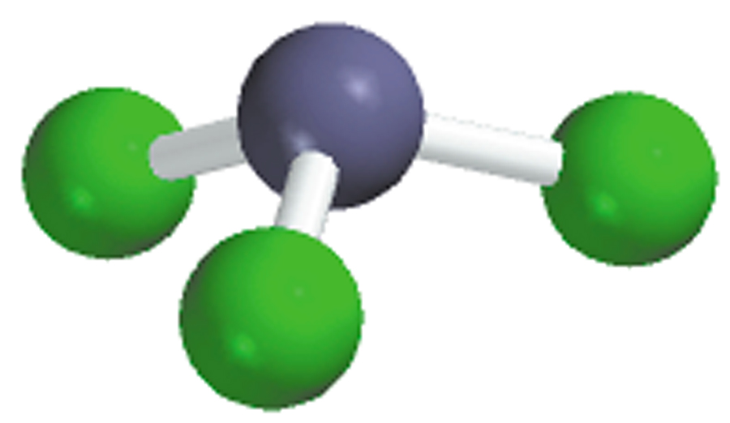
Write the Lewis structure of nitrogen trifluoride (NF₃).
Step 1 – N is less electronegative than F, put N in center
Step 2 – Count valence electrons N - 5 (2s²2p³) and F - 7 (2s²2p⁵)
5 + (3 x 7) = 26 valence electrons
Step 3 – Draw single bonds between N and F atoms and complete
octets on N and F atoms.
Step 4 - Check, are # of e⁻ in structure equal to number of valence e⁻ ?
3 single bonds (3x2) + 10 lone pairs (10x2) = 26 valence electrons
F
N
F
F
9.6

Slide 144
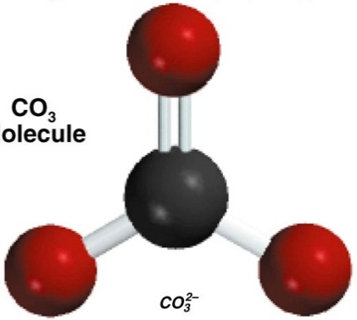
Write the Lewis structure of the carbonate ion (CO₃²⁻).
Step 1 – C is less electronegative than O, put C in center
Step 2 – Count valence electrons C - 4 (2s²2p²) and O - 6 (2s²2p⁴)
    -2 charge – 2e⁻
4 + (3 x 6) + 2 = 24 valence electrons
Step 3 – Draw single bonds between C and O atoms and complete
octet on C and O atoms.
Step 4 - Check, are # of e⁻ in structure equal to number of valence e⁻ ?
3 single bonds (3x2) + 10 lone pairs (10x2) = 26 valence electrons
Step 5 - Too many electrons, form double bond and re-check # of e⁻
2 single bonds (2x2) = 4
O
C
O
1 double bond = 4
8 lone pairs (8x2) = 16
Total = 24
O
9.6

Slide 145
Two possible skeletal structures of formaldehyde (CH₂O)
H
H
C
O
H
C
O
H
An atom’s formal charge is the difference between the number of valence electrons in an isolated atom and the number of electrons assigned to that atom in a Lewis structure.
formal charge on an atom in a Lewis structure
total number of valence electrons in the free atom
total number of nonbonding electrons
(
total number of bonding electrons
1
)
=
-
-
2
The sum of the formal charges of the atoms in a molecule or ion must equal the charge on the molecule or ion.
9.7

Slide 146
-1
+1
C – 4 e⁻
2 single bonds (2x2) = 4
H
C
O
H
O – 6 e⁻
1 double bond = 4
2H – 2x1 e⁻
2 lone pairs (2x2) = 4
12 e⁻
Total = 12
formal charge on an atom in a Lewis structure
total number of valence electrons in the free atom
total number of nonbonding electrons
(
total number of bonding electrons
1
)
=
-
-
2
formal charge on C
= 4 -
2 -
½ x 6 = -1
formal charge on O
= 6 -
2 -
½ x 6 = +1
9.7

Slide 147
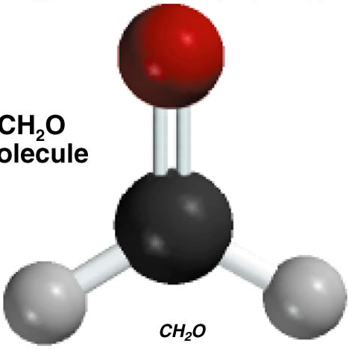
0
0
C – 4 e⁻
2 single bonds (2x2) = 4
H
C
O
O – 6 e⁻
1 double bond = 4
H
2H – 2x1 e⁻
2 lone pairs (2x2) = 4
12 e⁻
Total = 12
formal charge on an atom in a Lewis structure
total number of valence electrons in the free atom
total number of nonbonding electrons
(
total number of bonding electrons
1
)
=
-
-
2
formal charge on C
= 4 -
0 -
½ x 8 = 0
formal charge on O
= 6 -
4 -
½ x 4 = 0
9.7

Slide 148
Formal Charge and Lewis Structures
For neutral molecules, a Lewis structure in which there are no formal charges is preferable to one in which formal charges are present.
Lewis structures with large formal charges are less plausible than those with small formal charges.
Among Lewis structures having similar distributions of formal charges, the most plausible structure is the one in which negative formal charges are placed on the more electronegative atoms.
Which is the most likely Lewis structure for CH₂O?
-1
+1
0
0
H
H
C
O
H
C
O
H
9.7

Slide 149
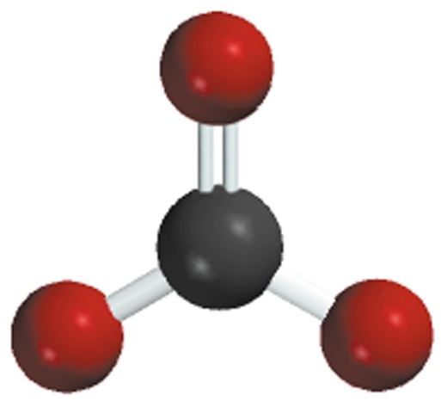
A resonance structure is one of two or more Lewis structures for a single molecule that cannot be represented accurately by only one Lewis structure.
+
-
-
+
O
O
O
O
O
O
What are the resonance structures of the
carbonate (CO₃²-) ion?
-
-
-
-
O
C
O
O
C
O
O
C
O
O
O
O
-
-
9.8

Slide 150
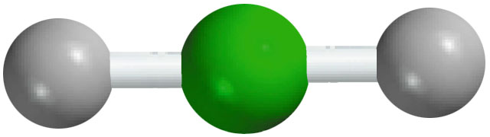
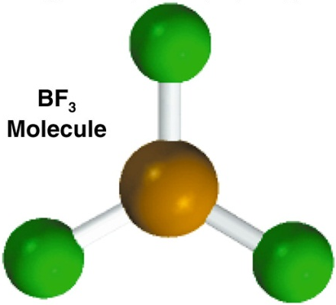
Exceptions to the Octet Rule
The Incomplete Octet
Be – 2e⁻
BeH₂
2H – 2x1e⁻
H
Be
H
4e⁻
B – 3e⁻
3 single bonds (3x2) = 6
F
B
F
BF₃
3F – 3x7e⁻
9 lone pairs (9x2) = 18
24e⁻
Total = 24
F
9.9

Slide 151
Exceptions to the Octet Rule
Odd-Electron Molecules
N – 5e⁻
NO
O – 6e⁻
N
O
11e⁻
The Expanded Octet (central atom with principal quantum number n > 2)
F
F
F
S – 6e⁻
6 single bonds (6x2) = 12
SF₆
6F – 42e⁻
S
18 lone pairs (18x2) = 36
48e⁻
Total = 48
F
F
F
9.9

Slide 152


